Slide 1
COSE421 class project
Self driving toy car
2021320115 이정원

Slide 2
Table of Contents
Hardware implementation
Devices
Pin configurations
Software implementation
Main
Setups
Handlers

Slide 3
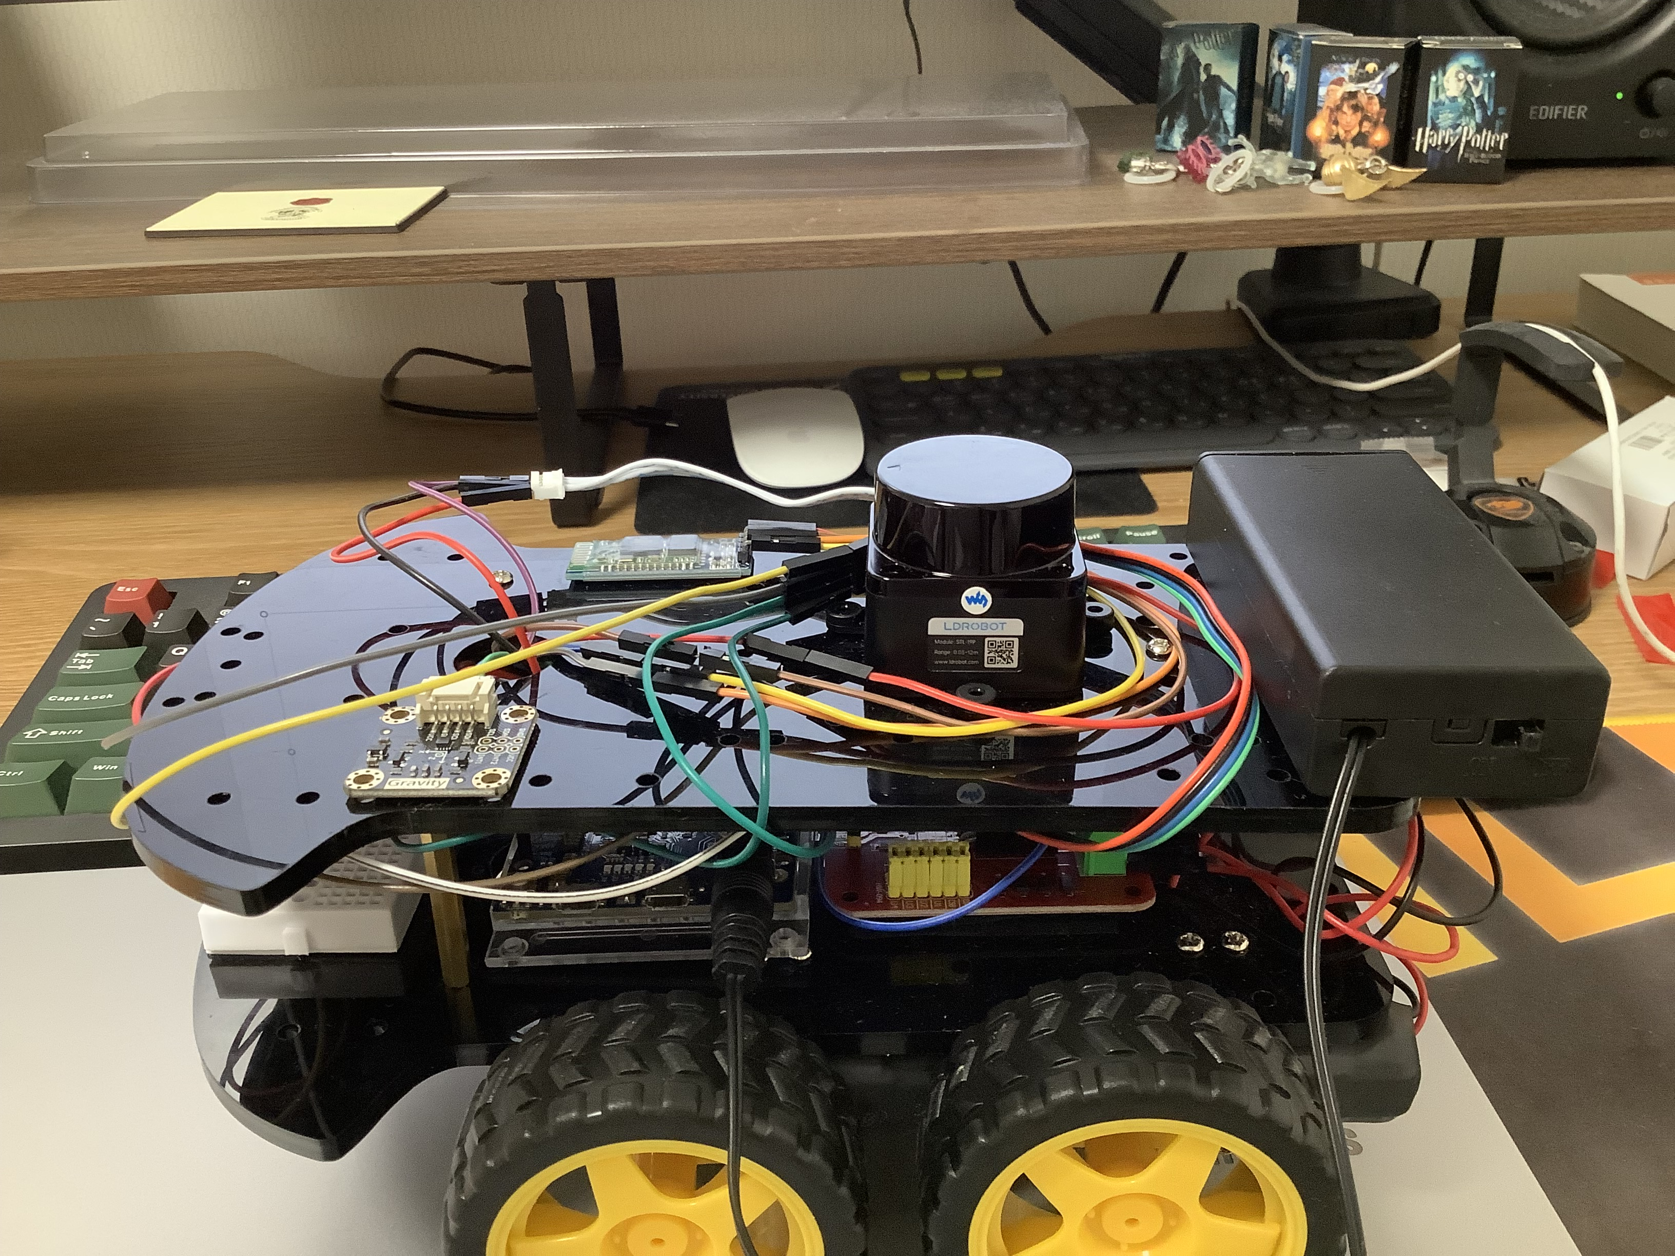
Hardware implementation
Devices I used : Lidar sensor, Motor driver, Bluetooth module, Accelerometer
Lidar sensor
Bluetooth module
Accelerometer
Zero board
Motor driver

Slide 4
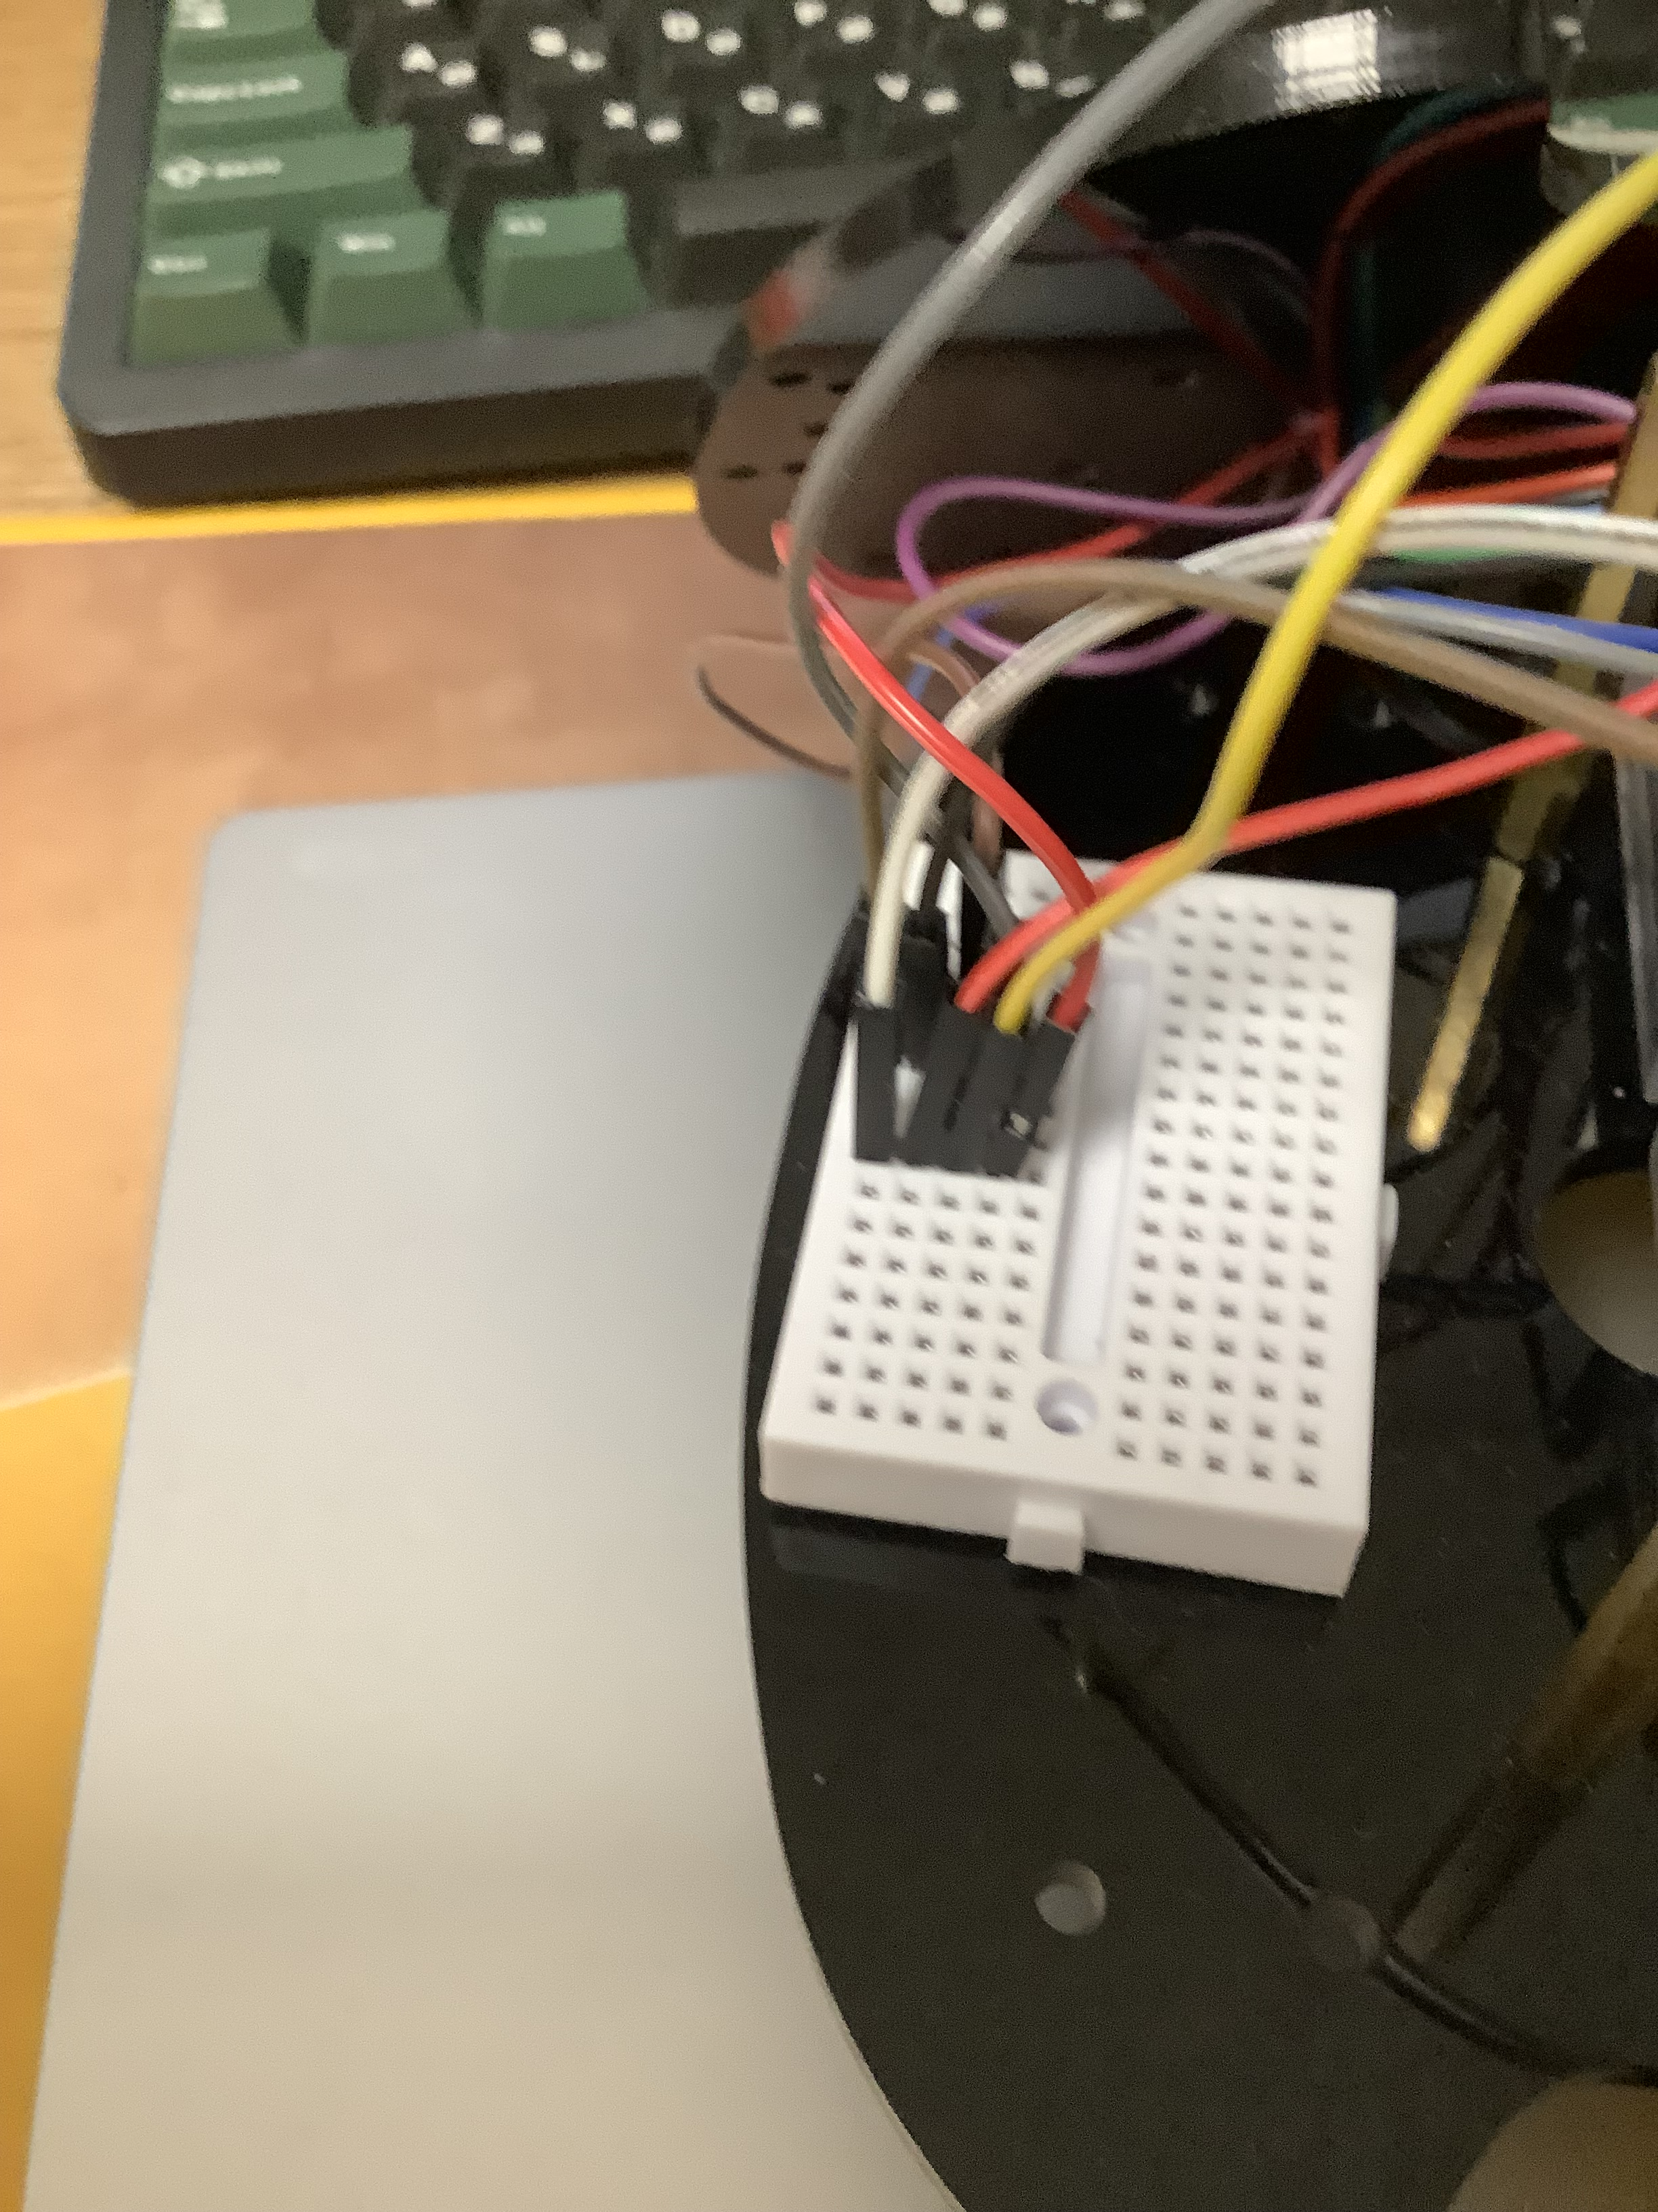
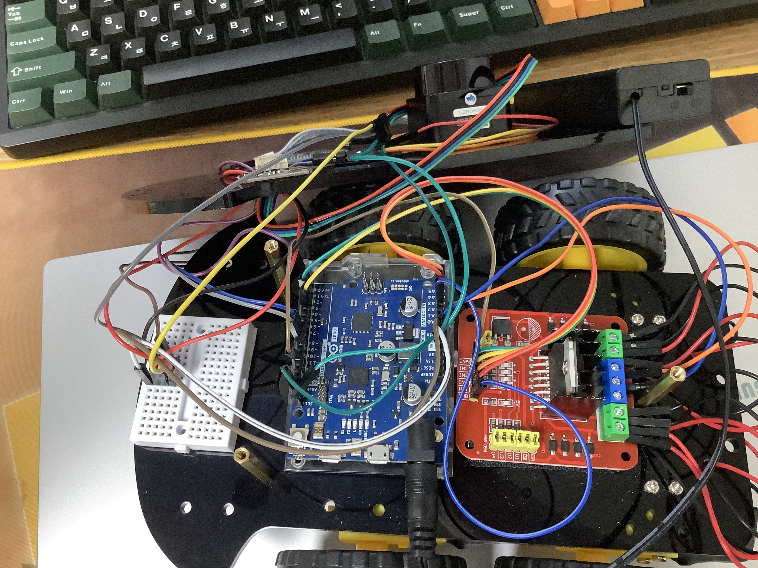
Pin configuration
UART(Lidar) (PA11)
ENB (PB09)
GND
UART(BT) (PA06, 07)
PORT (IN1-4) (PA04, 05, 08, 09)
5V
ENA (PA19)
Lidar, BT, Aclr
VMS, GND
SDA, SCL (PA22, 23)
5V, GND

Slide 5
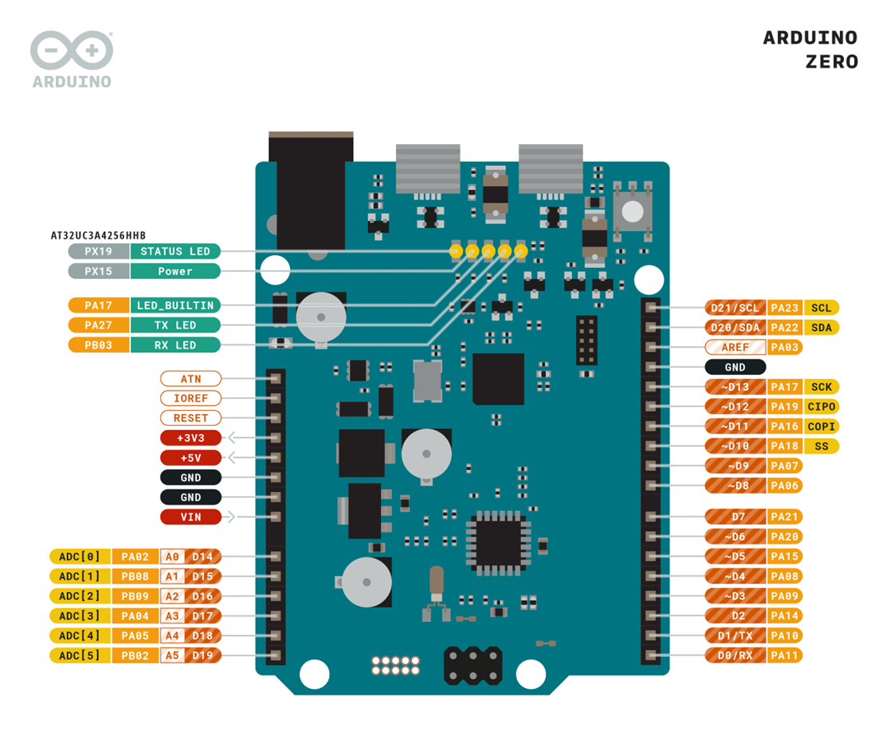
Aclr
M/D
Lidar, BT, Aclr
Aclr
M/D
UART(Lidar) (PA11)

Slide 6
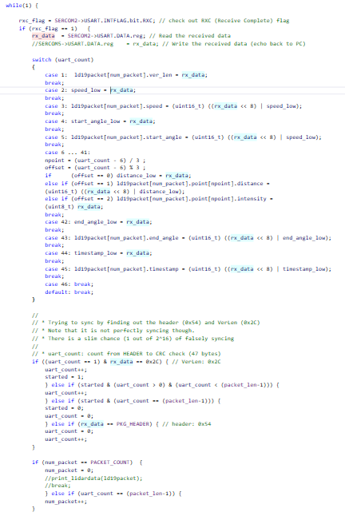
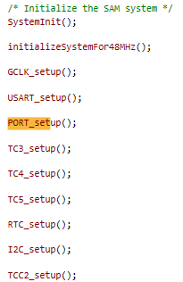
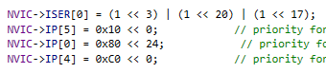
Software implementation
Setup NVIC
Priority : TC5, RTC, TCC2
TC5: move straight
RTC: detect wall + turn
TCC2: send speed of the car
Initialize and call all setup functions
=> Configurations before normal operations
Forever loop: get 100 packets each form lidar sensor

Slide 7
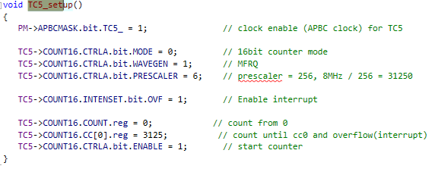
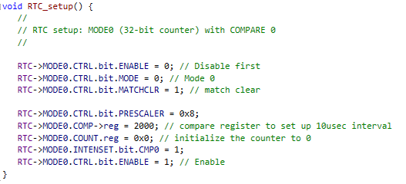
Setups
Faster period
(stop)

Slide 8
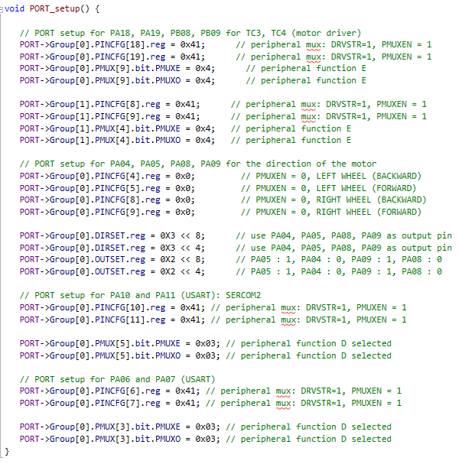
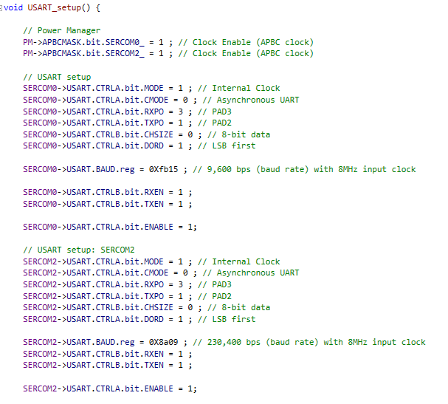
Setups
SERCOM0 (UART) : Bluetooth -> Tera Term
SERCOM2 (UART) : LIDAR

Slide 9
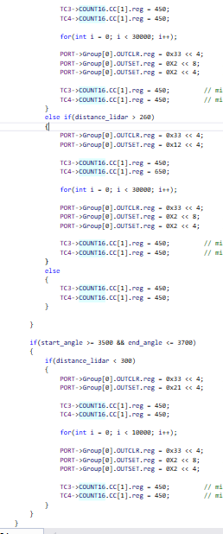
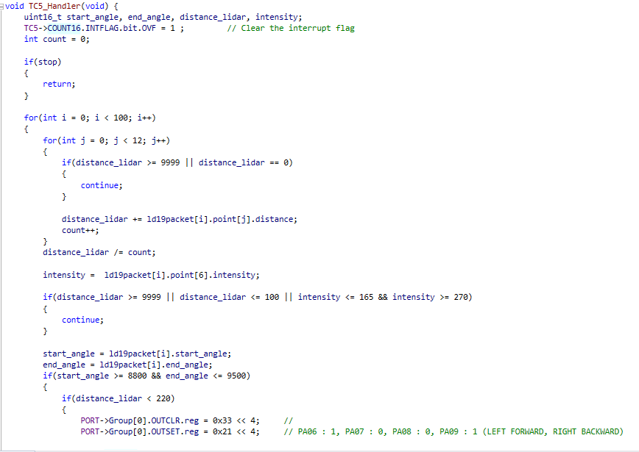
Handlers
Look for the LIDAR data to find right side(90, 36 degree) distance
To use correct distance:
Discard error data, low/high intensity
Use average of 12 measurements
If distance is longer than 260mm(for 90 degree), left wheel move faster
Opposite for 220 mm (90 degree)

Slide 10
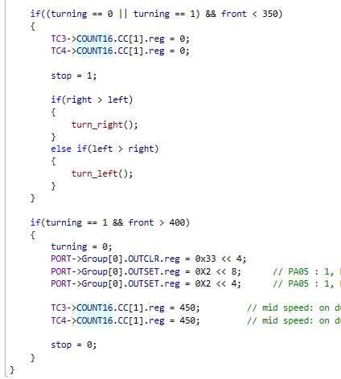
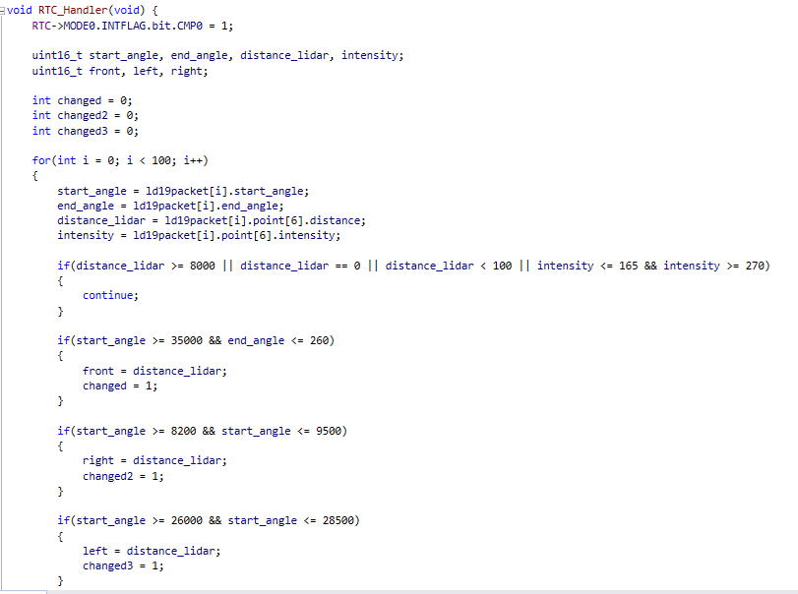
Handlers
Look for the LIDAR data to find front(0 degree) distance
To use correct distance
Discard error data (9999, 0)
If distance is shorter than 500, stop and see if left/right is open.
Turn to the opened side. Continue calling turning function until front is open

Slide 11
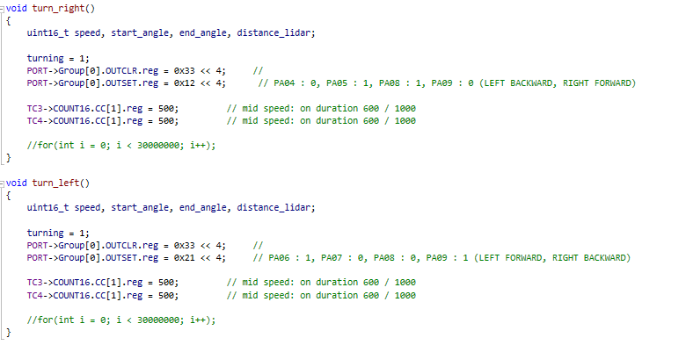
Turning functions
Sets the direction of motors oppositely and provide speed each

Slide 12
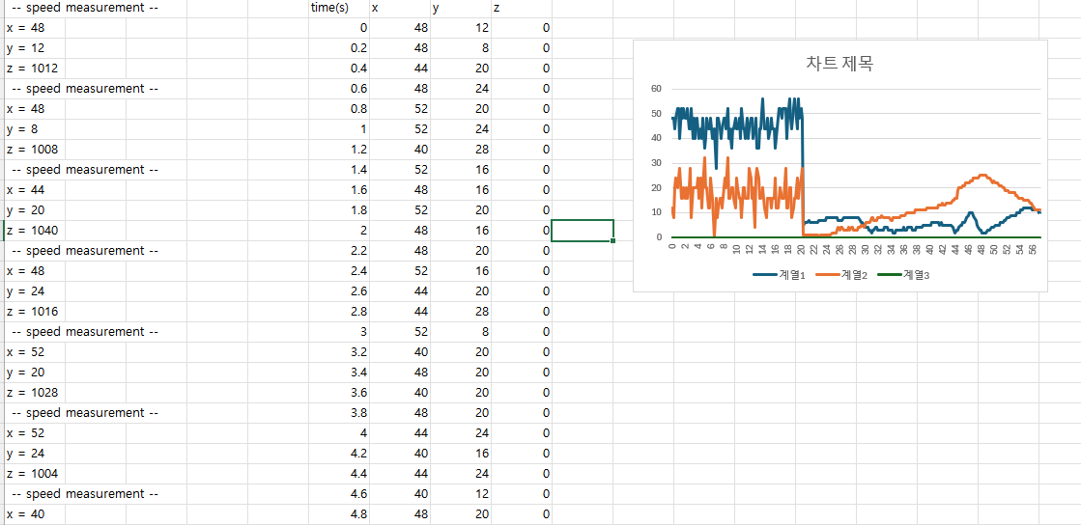
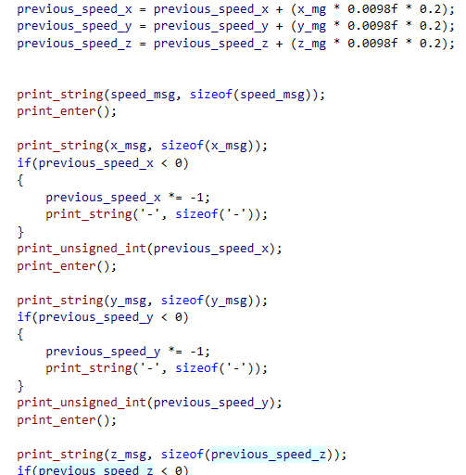
Speed graph
Paste Tera Term message, then the data will be filled in the chart and show as a graph
* The graph will be shown as a linear graph, because the gravitational acceleration is kept detected all the time. So, the graph is incorrect, I think.

Slide 13
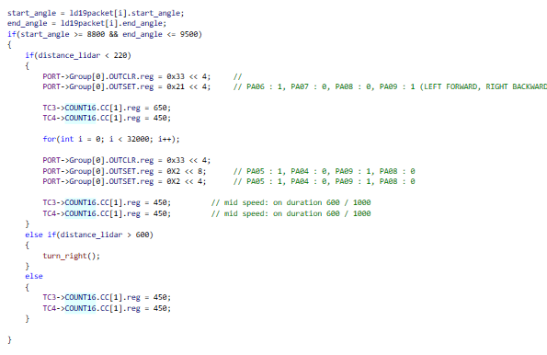
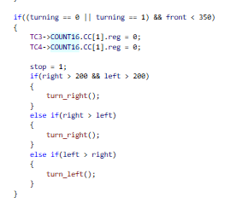
Maze

Slide 14
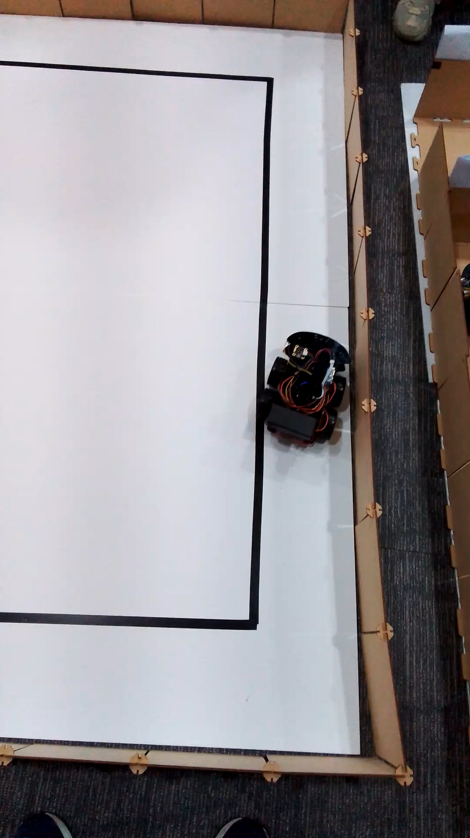
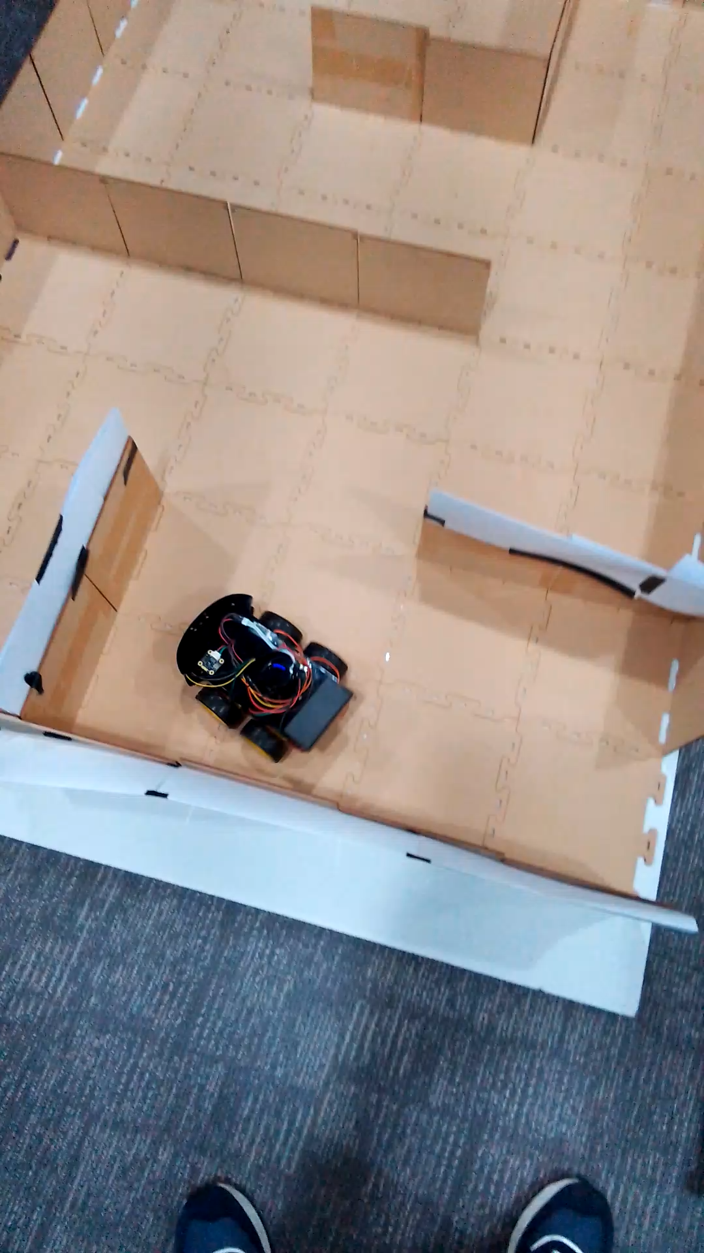
Demo

